Slide 1
Saas customer Churn Analysis
What’s driving customer loss and what to do about it.
Crystal Brown
2026

Slide 2
The Situation
A SaaS company asked: Who is churning, When, and Why?
Analyzed 1,000 customer records from Jan 2024 to Jun 2025.
Three plan types investigated: Basic, Enterprise, and Pro.
Examined acquisition cost, plan type, and tenure as potential churn predictors.

Slide 3
What We Found
Something Changed in March 2025 and the data points directly to it.
Churn tripled in March 2025 and never recovered, spiking again in June 2025.
Plan type does not predict churn. Rates nearly identical: Basic 17.7%, Enterprise 17.3%, Pro 15.4%.
Acquisition Cost does not predict churn. Less than a $0.50 difference between active and churned customers.
Churn was stable throughout 2024 averaging 1-8 customers per month.

Slide 4
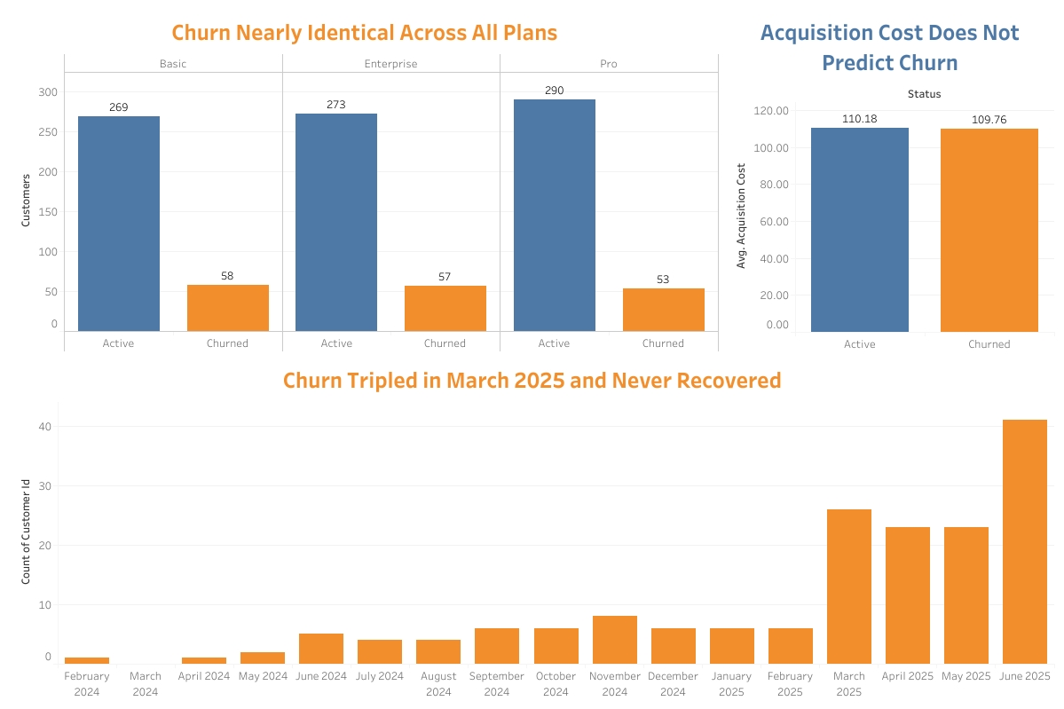
The Evidence

Slide 5
What This Means
This is not a customer profile problem, it’s a timing event issue and requires investigation.
Adjusting pricing, plan targeting, or acquisition strategy will not fix this.
Something changed in or around March 2025 causing a shift in retention.
Until the root cause is identified any retention intervention is guess work.

Slide 6
Recommendations
Investigate March - June 2025
Cross reference marketing campaigns, support tickets, and development changelog.
Extend The Dataset To Present Day
Confirm if churn is still elevated or has been resolved.
Month 4 Proactive Outreach
Customer Success check-in before customers reach the churn window.
One Question Exit Survey
Direct evidence that no internal data analysis can’t replace.

Slide 7
Appendix - Methodology
All SQL queries available on Github
Data Source:
Tools:
Alterations:
SaaS Business Metrics Customers, Plans, and Revenue
Kaggle
1,000 records
SQL (SQLiteOnline)
Excel
Tableau Public
PowerPoint
Columns removed: Amount (duplicate of monthly_fee), Subscription sheet (no new information).
Joined files: Customers and Revenue using XLOOKUP on customer_id.
Calculated active customer tenure as of 06/30/2025 to avoid data staleness.

